Slide 1
Assignment 2
LLM Usage and Neural Networks

Slide 2
LLM Usage :
Zero-Shot Prompting
Few Shot Prompting
Chain-of-thought(CoT) prompting
Neural Network Modelling:
Feed Forward neural network classifier
Loan Dataset with decision as target
The goal is to study how prompting techniques improve LLM behavior and how classical neural networks perform on structured data.

Slide 3
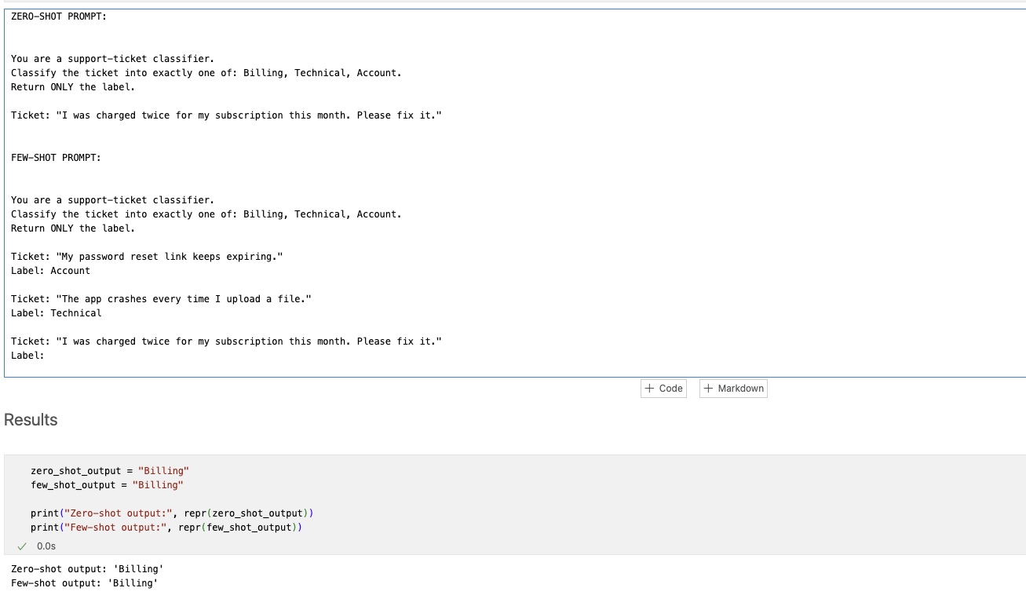
Zero-shot vs Few-shot Prompting
Zero-shot prompting:
The model is given only the task description
No examples are provided
Relies entirely on pre-trained knowledge
Few-shot prompting:
The model is shown a few labeled examples
Examples define task structure and output format
Experiment:
Task: classify a support ticket into Billing, Technical, or Account
Same input used for both prompts
Observation:
Few-shot prompting produced more consistent and cleaner outputs
Zero-shot sometimes added extra text or formatting variations

Slide 4
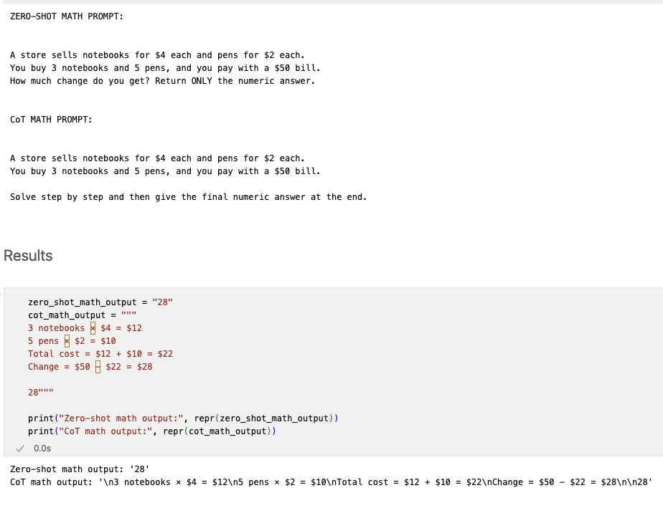
Chain-of-Thought (CoT) Prompting
Chain-of-Thought prompting explicitly asks the model to reason step by step before producing an answer.
Experiment:
Arithmetic word problem involving multiple steps
Compared:
Zero-shot (answer only)
CoT prompt (step-by-step reasoning)
Observation:
CoT prompting exposes intermediate calculations
Reduces the risk of arithmetic errors
Produces more reliable final answers
Conclusion:
CoT prompting improves reasoning on multi-step problems

Slide 5
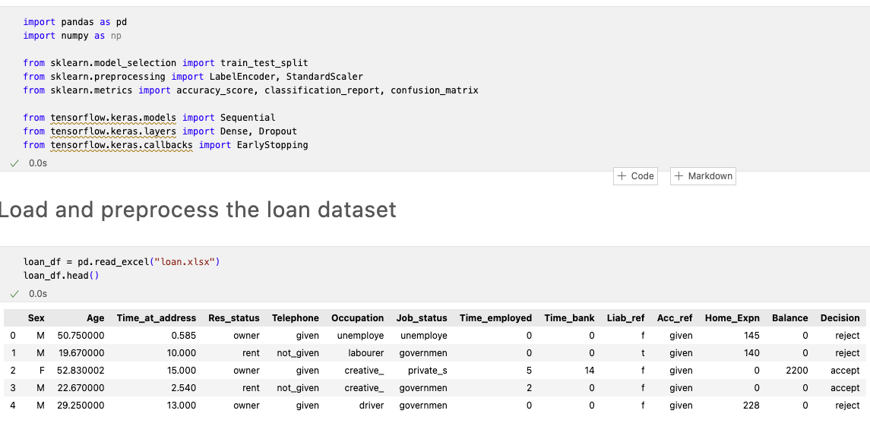
Neural network Setup and Data Preparation
Model:
Traditional feed-forward neural network (MLP)
Input → Hidden layers → Output
No recurrence or feedback loops
Dataset:
Loan dataset
Target variable: Decision (Accept / Reject)
Preprocessing:
Categorical variables → one-hot encoding
Features scaled using StandardScaler
Train-test split applied
Why scaling:
Neural networks are sensitive to feature magnitude
Scaling improves convergence and stability

Slide 6
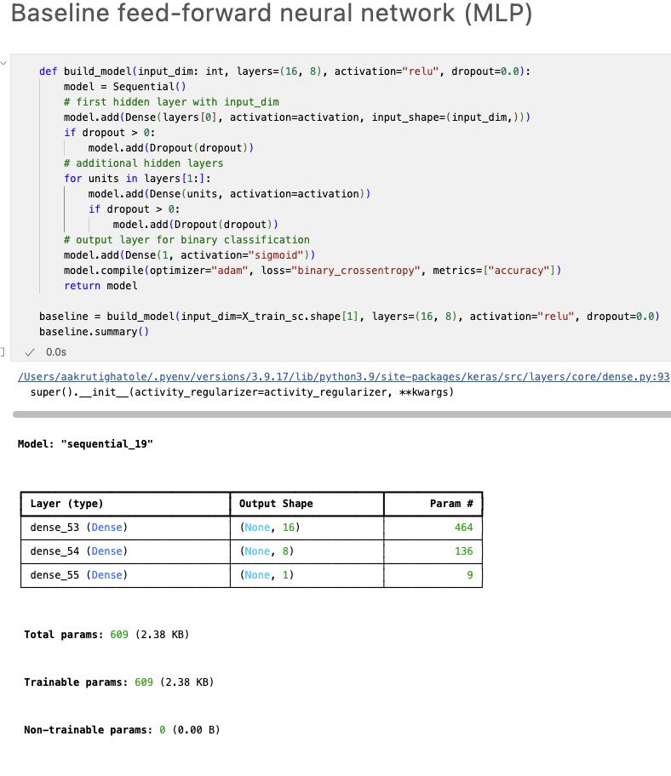
Neural Network Architecture and Tuning
Baseline architecture:
Two hidden layers
ReLU activation in hidden layers
Sigmoid activation in output layer
Binary cross-entropy loss
Adam optimizer
Model tuning explored:
Number of hidden layers (1–3)
Number of neurons per layer
Activation functions (ReLU, tanh)
Dropout for regularization
Selection criterion:
Best validation accuracy
Result:
Two hidden layers with ReLU performed best

Slide 7
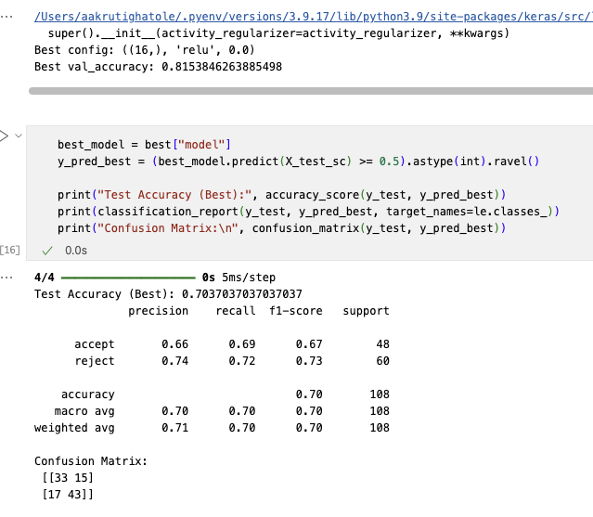
Results and Conclusions
LLM Prompting:
Few-shot prompting improves consistency and format control
Chain-of-Thought prompting improves reasoning accuracy
Prompt engineering significantly affects LLM output quality
Neural Networks:
Feed-forward neural networks work well for structured data
Proper preprocessing is essential
Architecture and activation choices impact performance
Overall:
Prompt design and model tuning are critical for reliable AI systems

